Slide 1
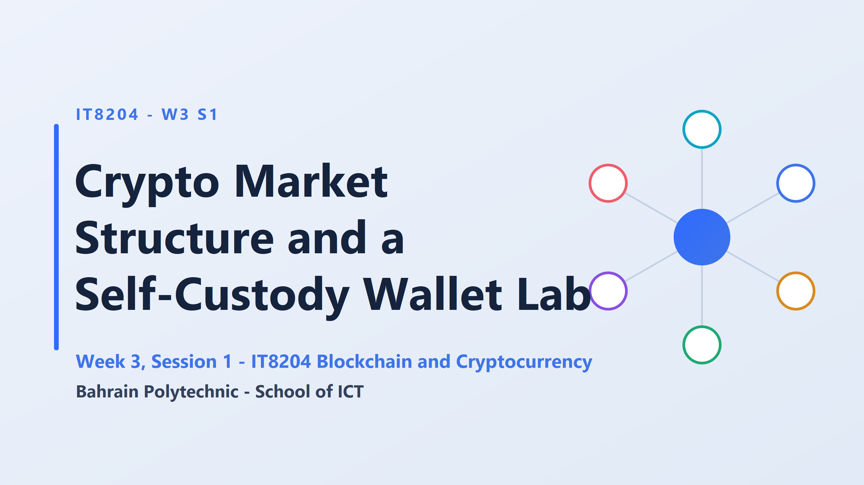

Slide 2
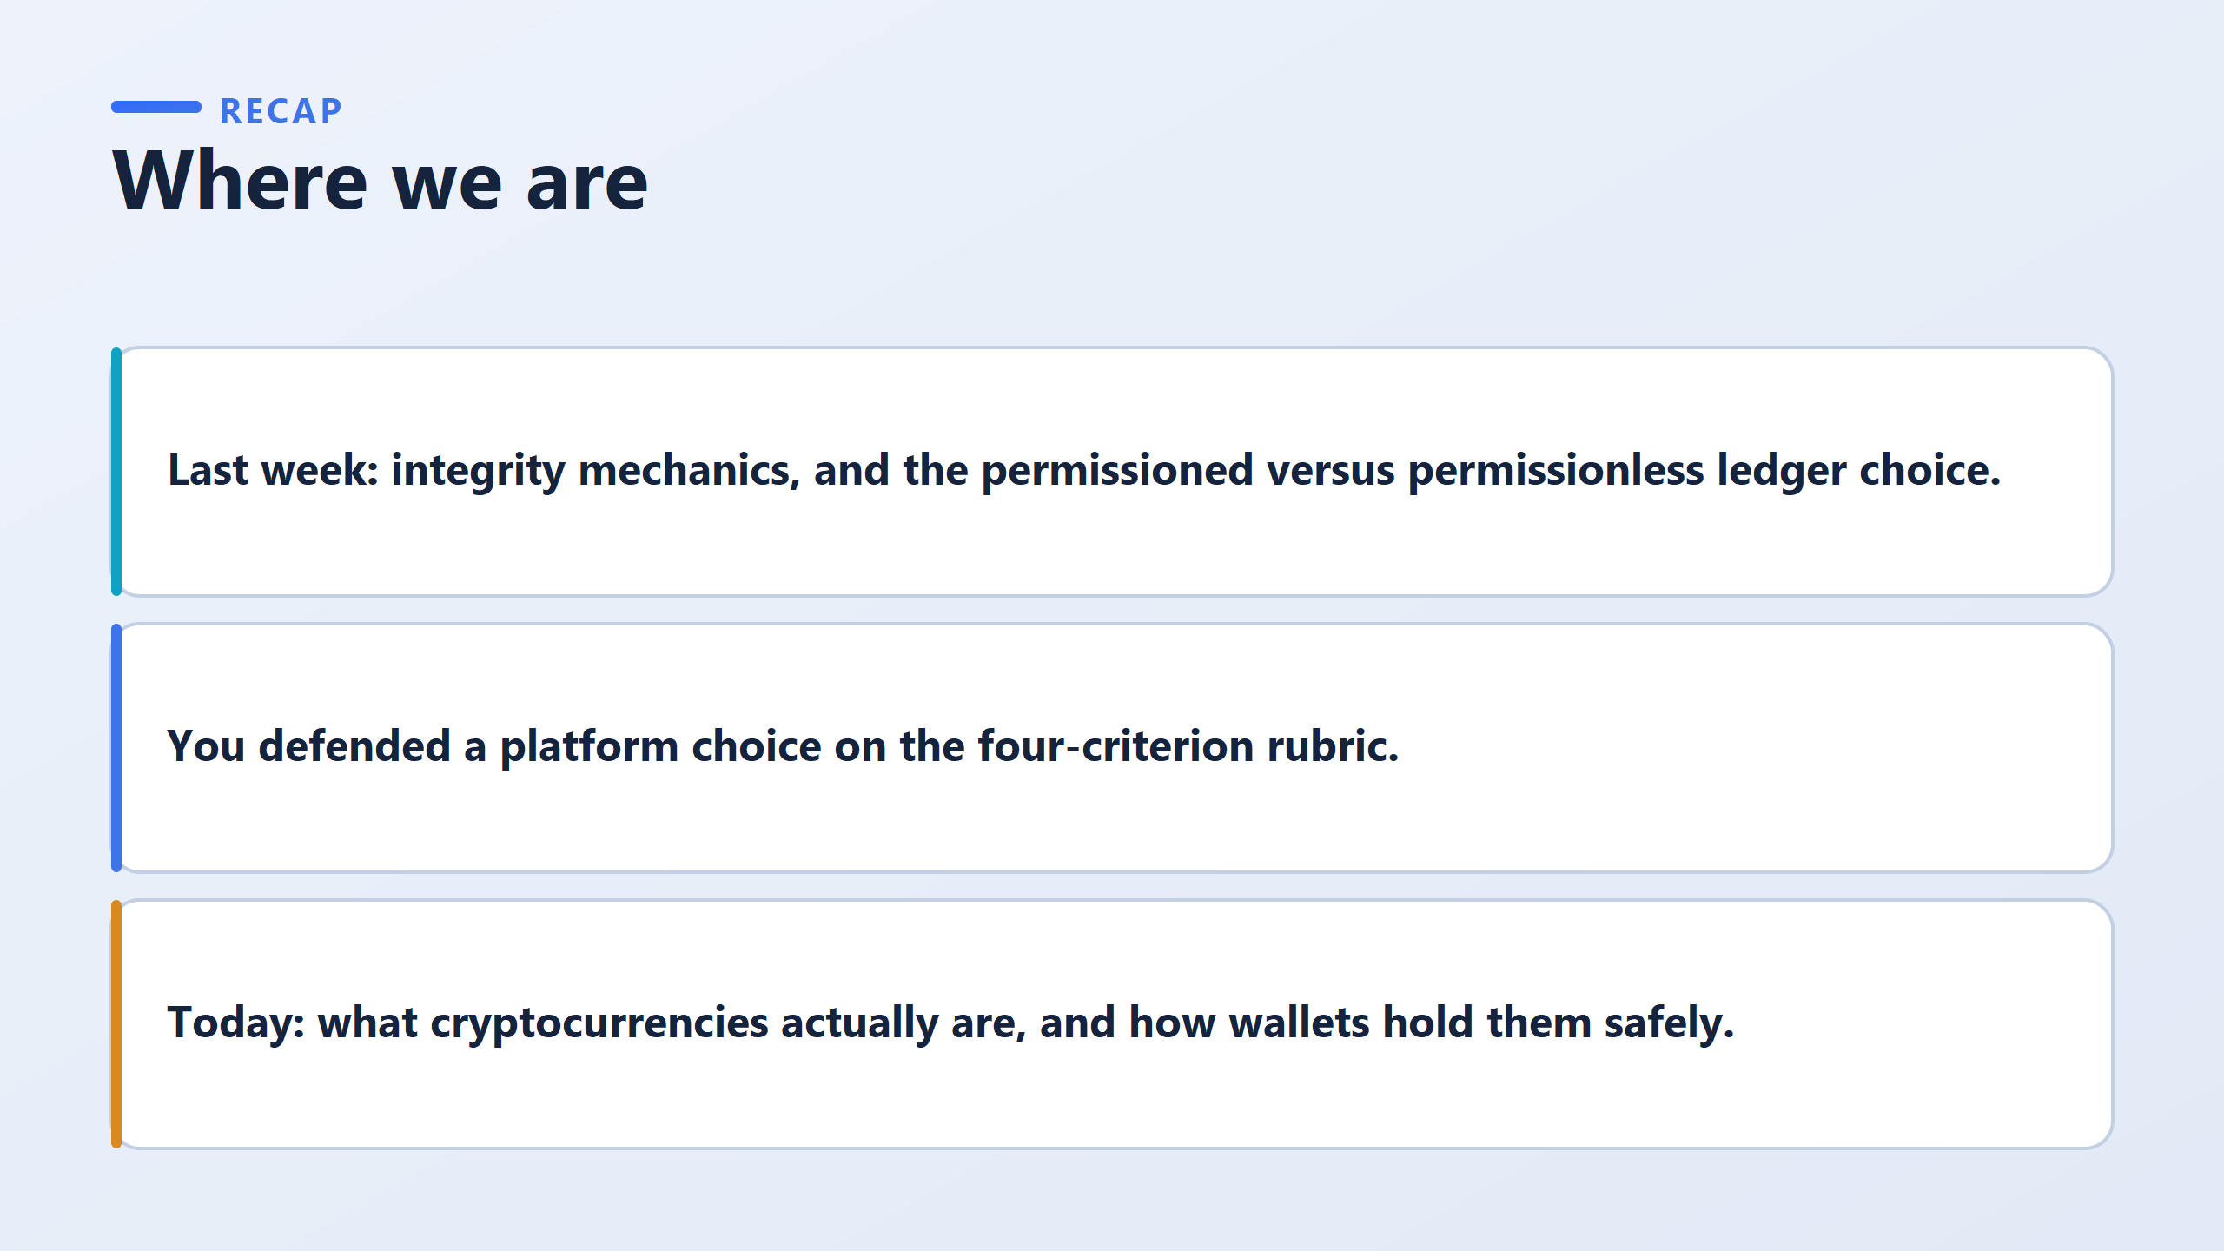

Slide 3
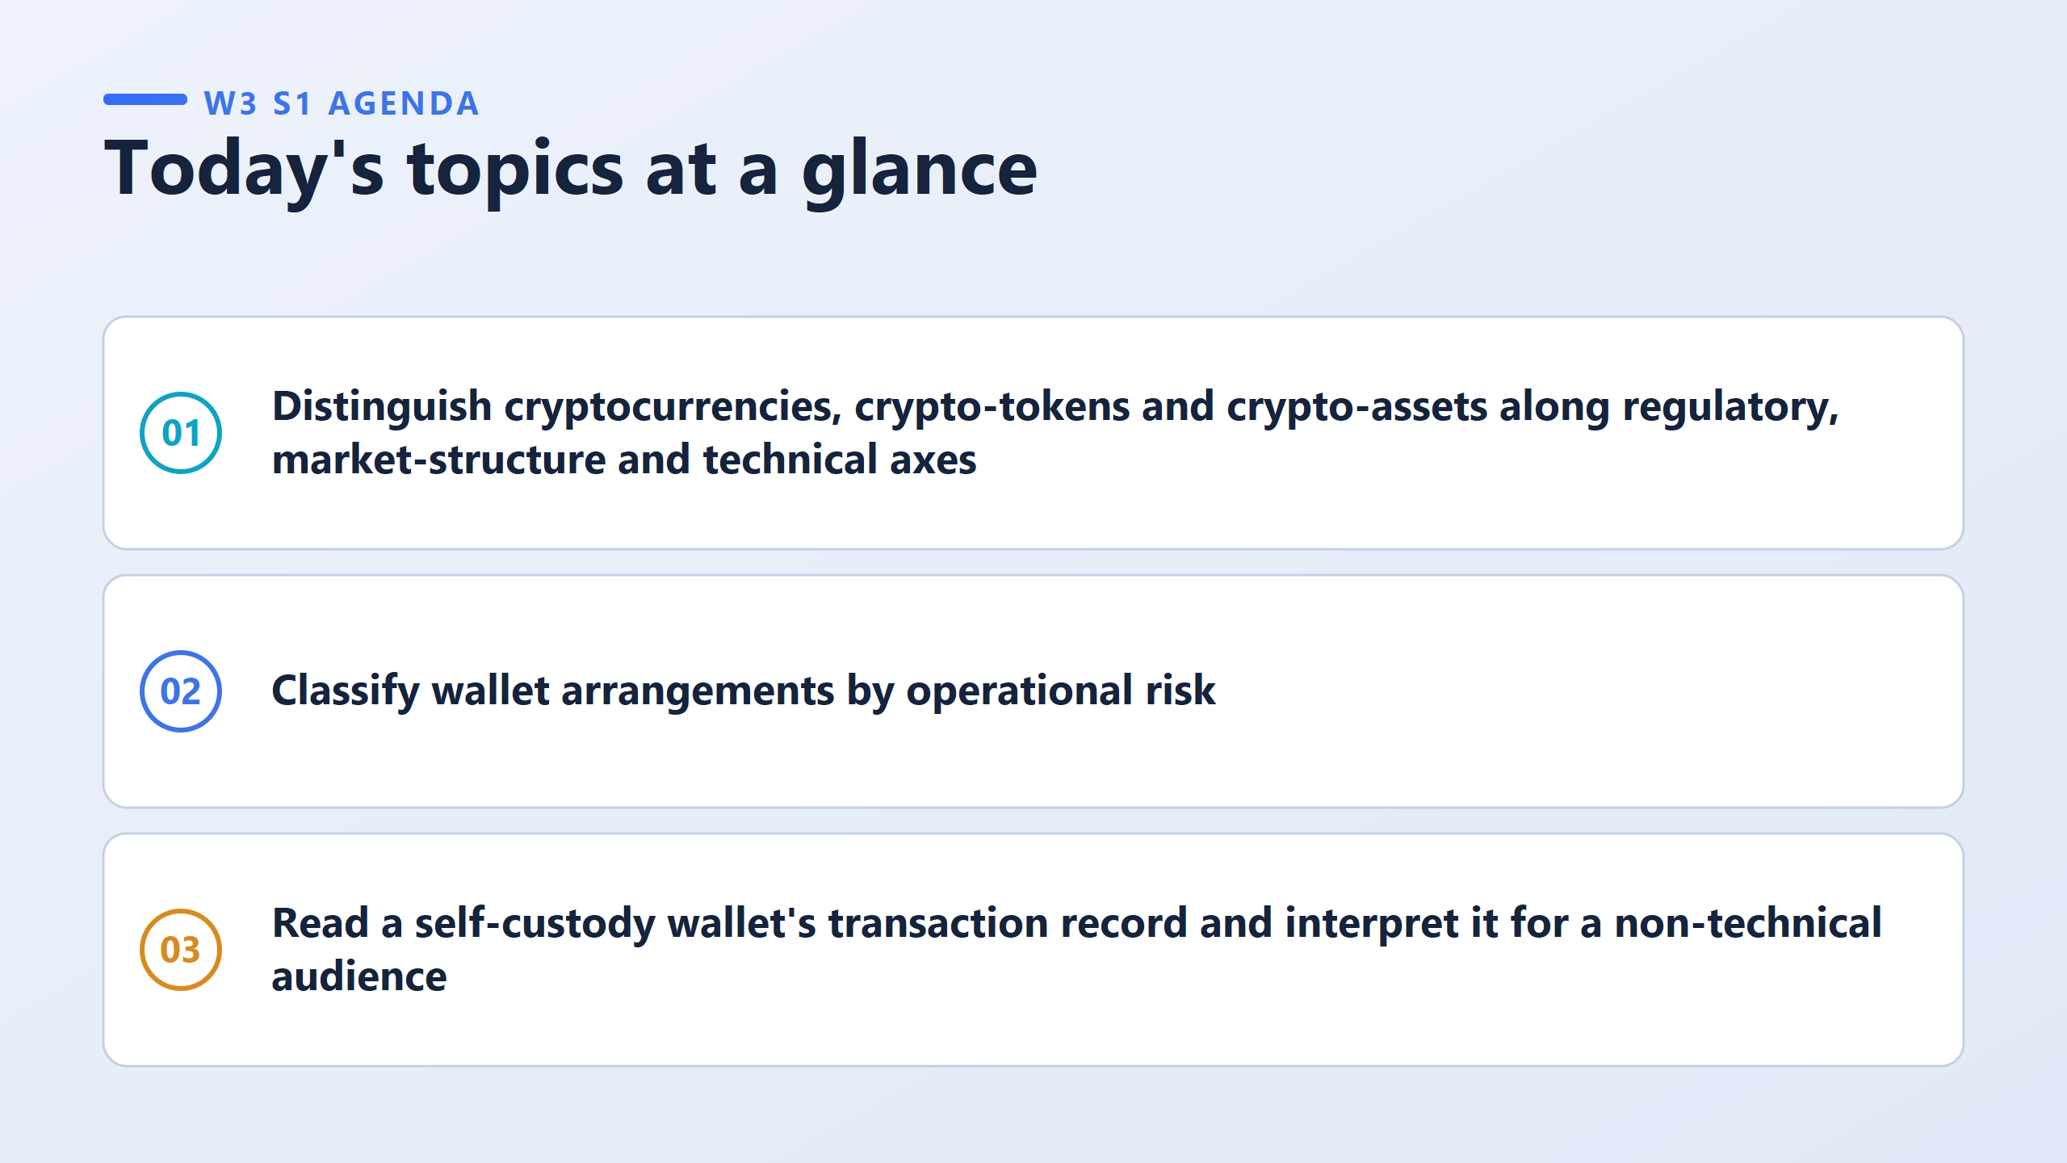
Cryptocurrency: Bitcoin, Ethereum, Solana
Crypto-tokens: Uniswap, Chainlink, Tether
Crypto-assets: ETH, NFTs, tokenized real estate, stablecoins
look at wallets — not as a single category, but ranked by risk. Some ways of holding crypto are safer than others, and you'll learn to place any wallet setup somewhere on that risk spectrum.
you'll actually open a wallet, make a transaction, and learn to read what that transaction record is telling you, well enough that you could explain it to someone who's never seen a blockchain explorer in their life.

Slide 4
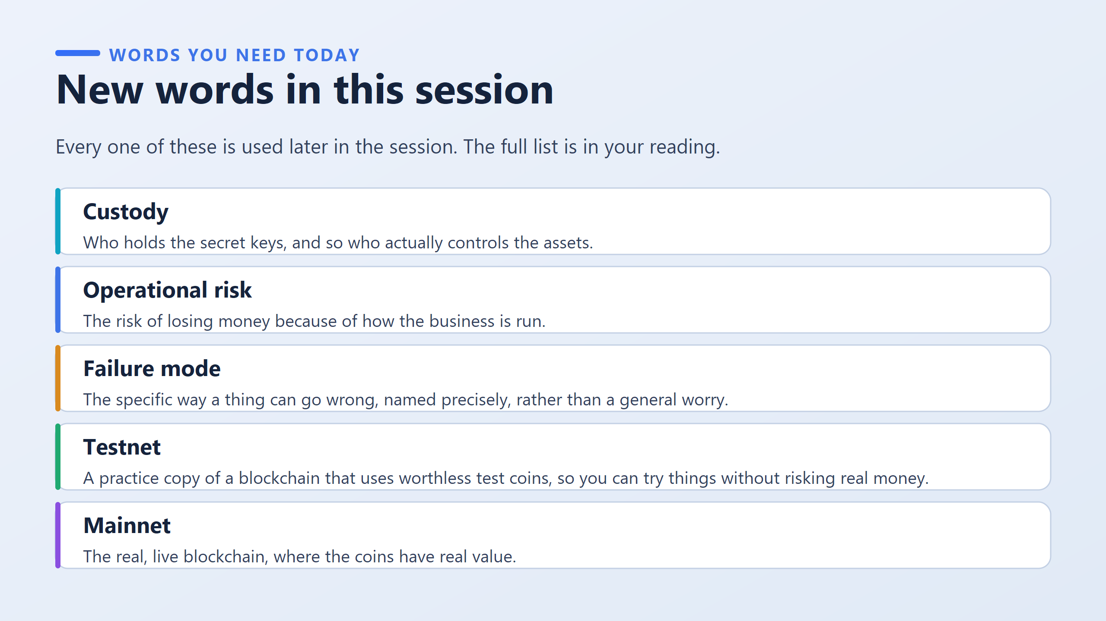
Custody | Whoever holds the key actually controls the coins
Operational risk | Losing money because a company messed up, not the tech
Failure mode | The exact, specific way something breaks
Testnet | Practice version, fake coins, zero real risk
Mainnet | The real network, real coins, real consequences

Slide 5
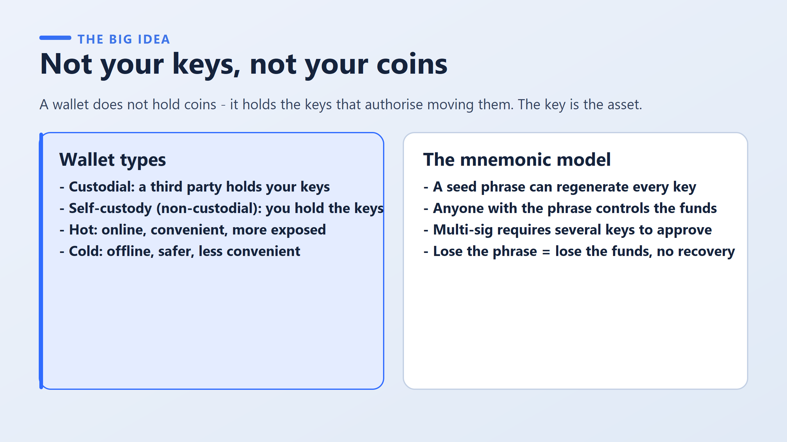
 | Hot (online) | Cold (offline)
Custodial | Your everyday balance on Binance, Coinbase, or Kraken — sitting in the exchange's active pool, ready to trade or withdraw instantly | The exchange’s own vault storage — e.g. Coinbase Custody, or institutional custodians like BitGo or Fireblocks, who keep the vast majority of customer funds offline and only move small amounts to hot wallets as needed
Self-custody | MetaMask, Trust Wallet, Phantom (for Solana) — apps on your own phone or browser where you hold the key yourself, but the app stays connected to the internet | Ledger or Trezor — small physical USB-like devices that store your key completely offline; you plug it in only to approve a transaction, then it disconnects
how a key can be rebuilt
Next: if the key is the asset, then judging any wallet means judging how the key is held, which is exactly the checklist coming up.

Slide 6
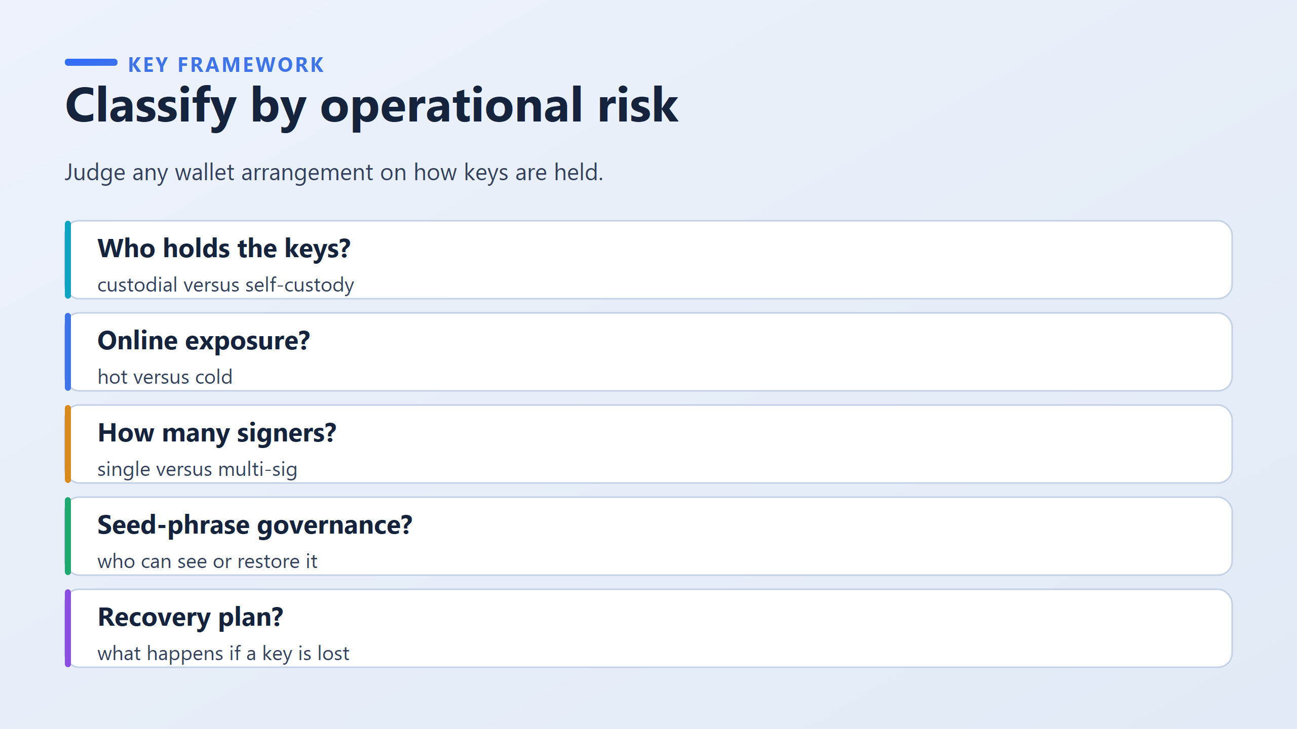
does moving the money require one approval, or several?
Single-sig = one key is enough.
You alone can approve and send a transaction.
Simple, but if that one key is ever stolen or lost, that’s the whole game over.
Multi-sig = requires several separate keys to agree before anything moves.
Like a safety deposit box that needs two different bank employees to insert their keys together — no single person can open it alone.
The idea is: no matter what wallet setup you're looking at — an exchange account, a MetaMask wallet, a hardware device, anything — you can judge how risky it is by asking these five same questions every time.
Think of it like a doctor running the same five checks on every patient, regardless of what's wrong with them.

Slide 7
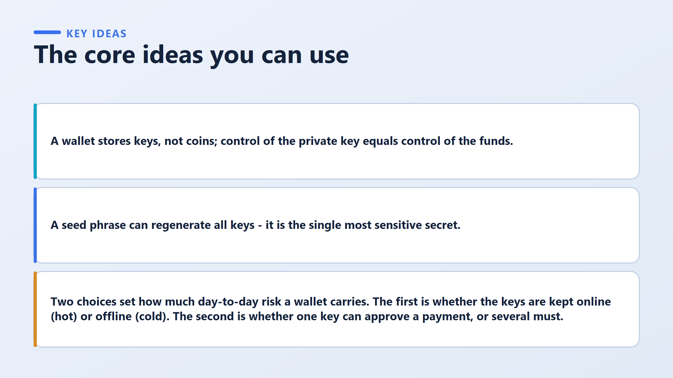

Slide 8
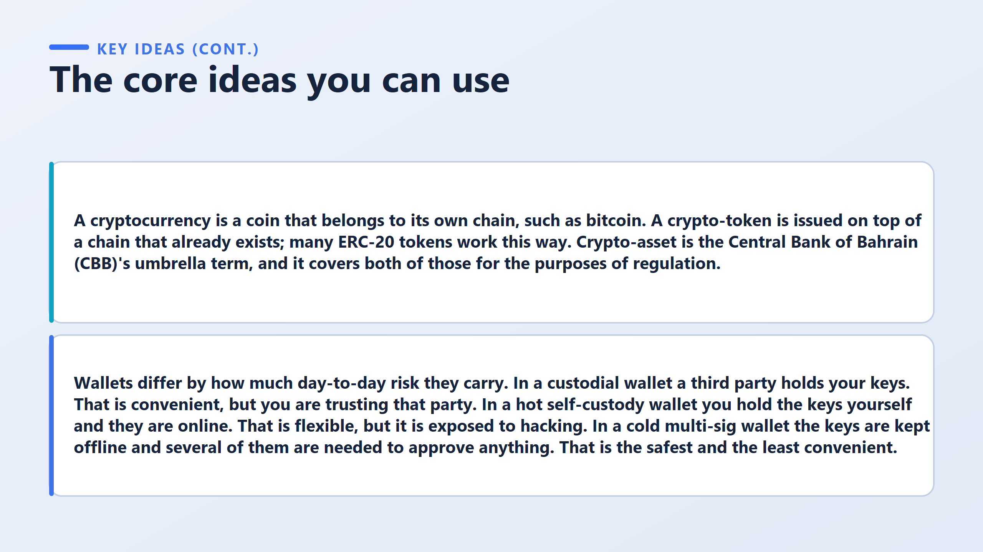

Slide 9
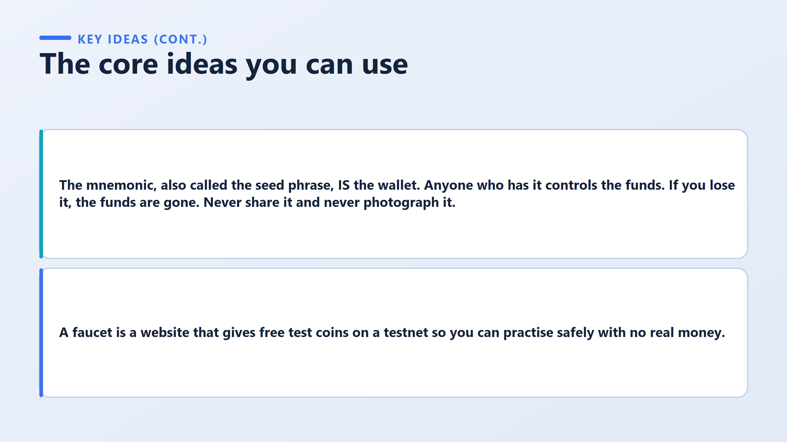

Slide 10
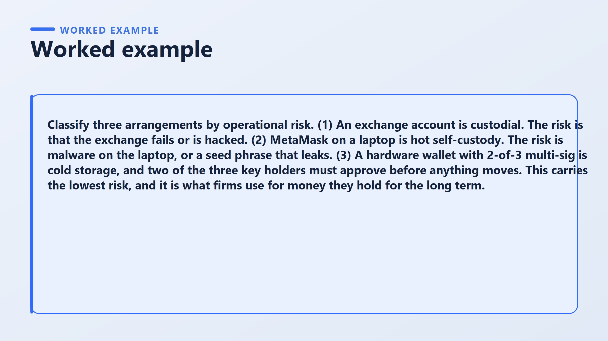

Slide 11
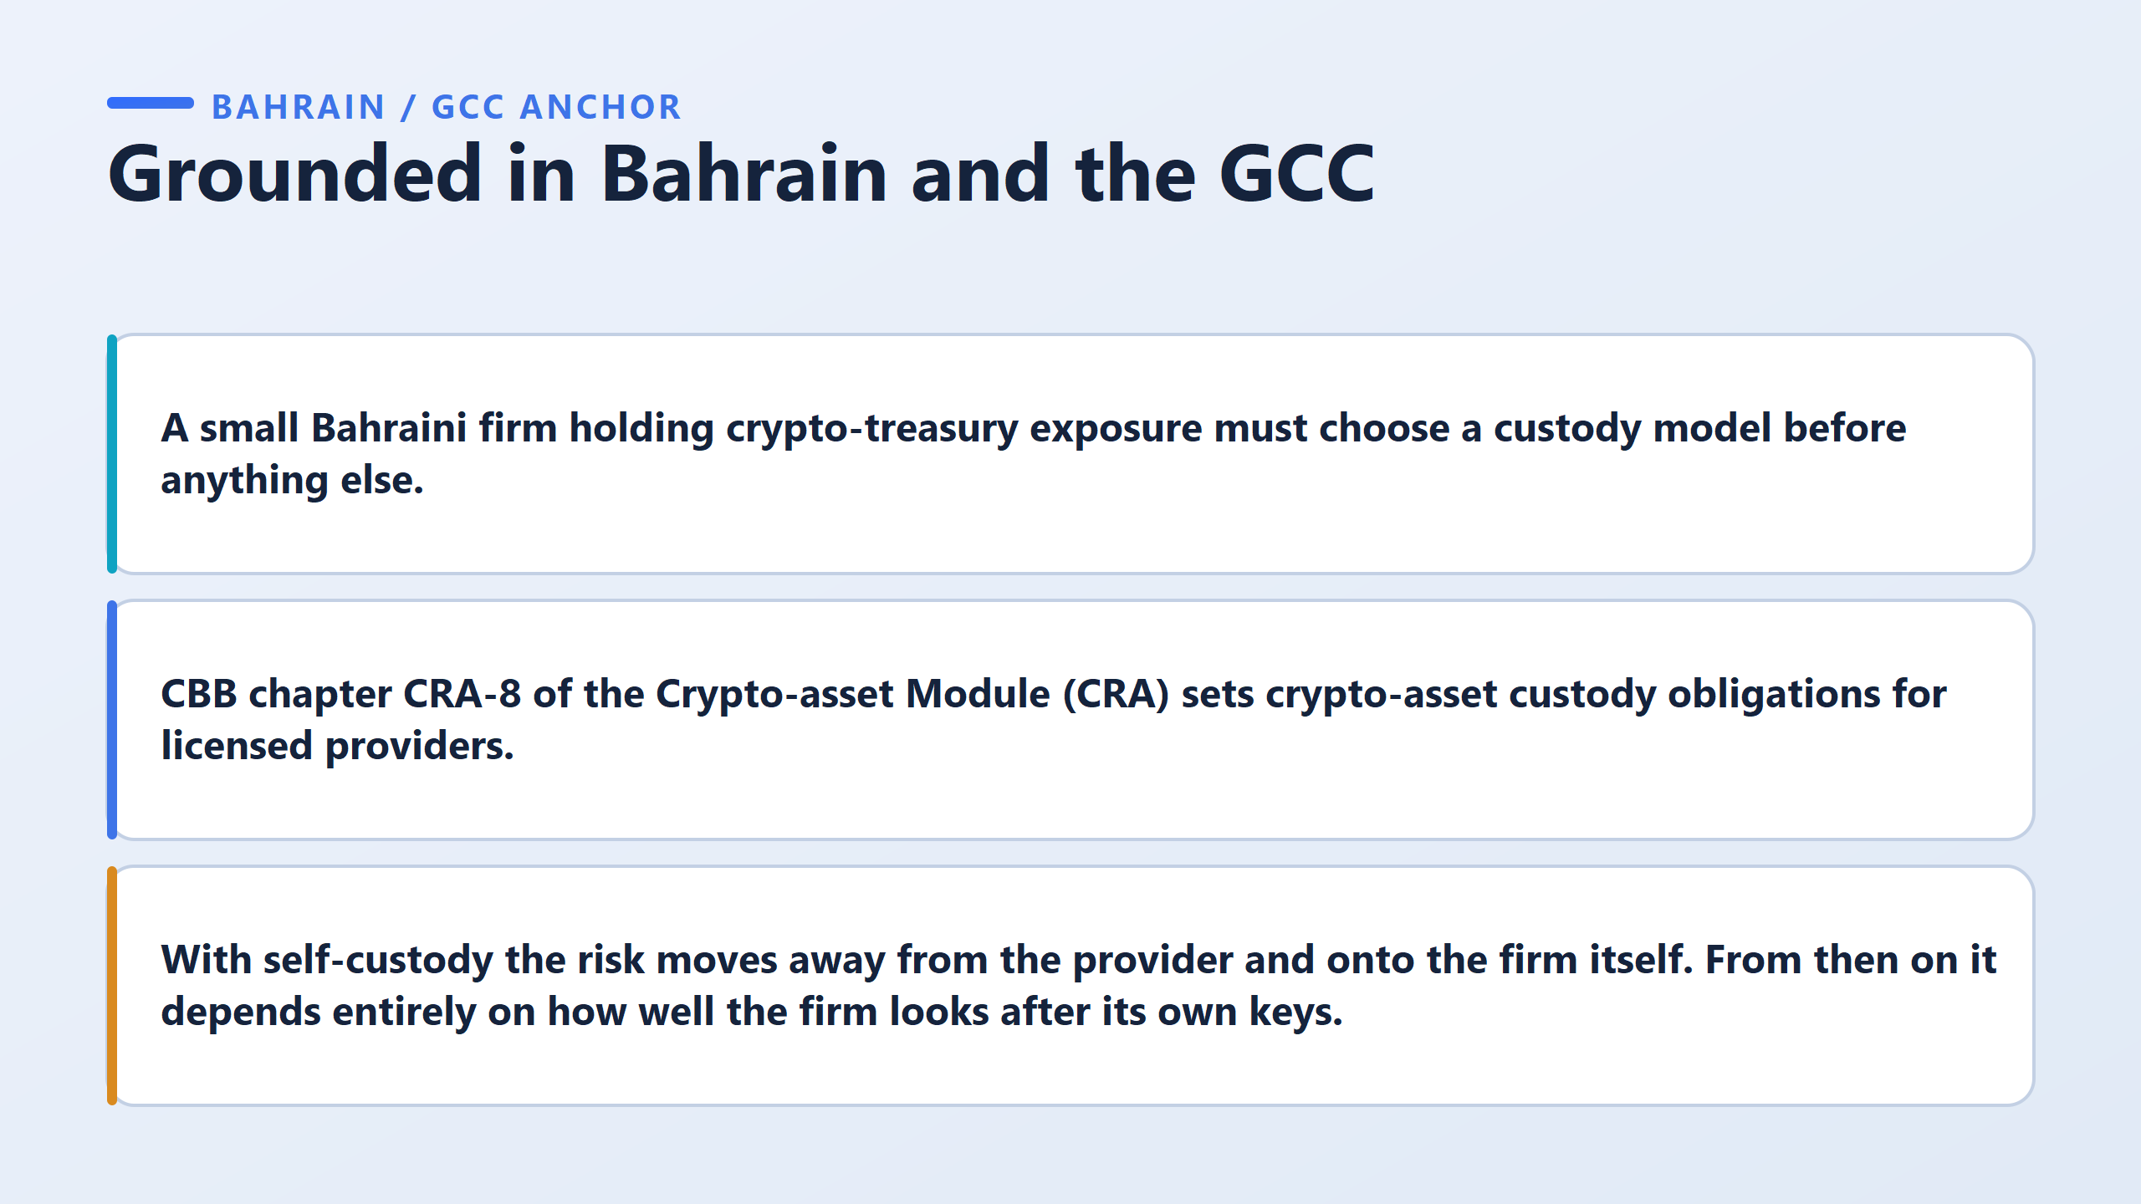

Slide 12
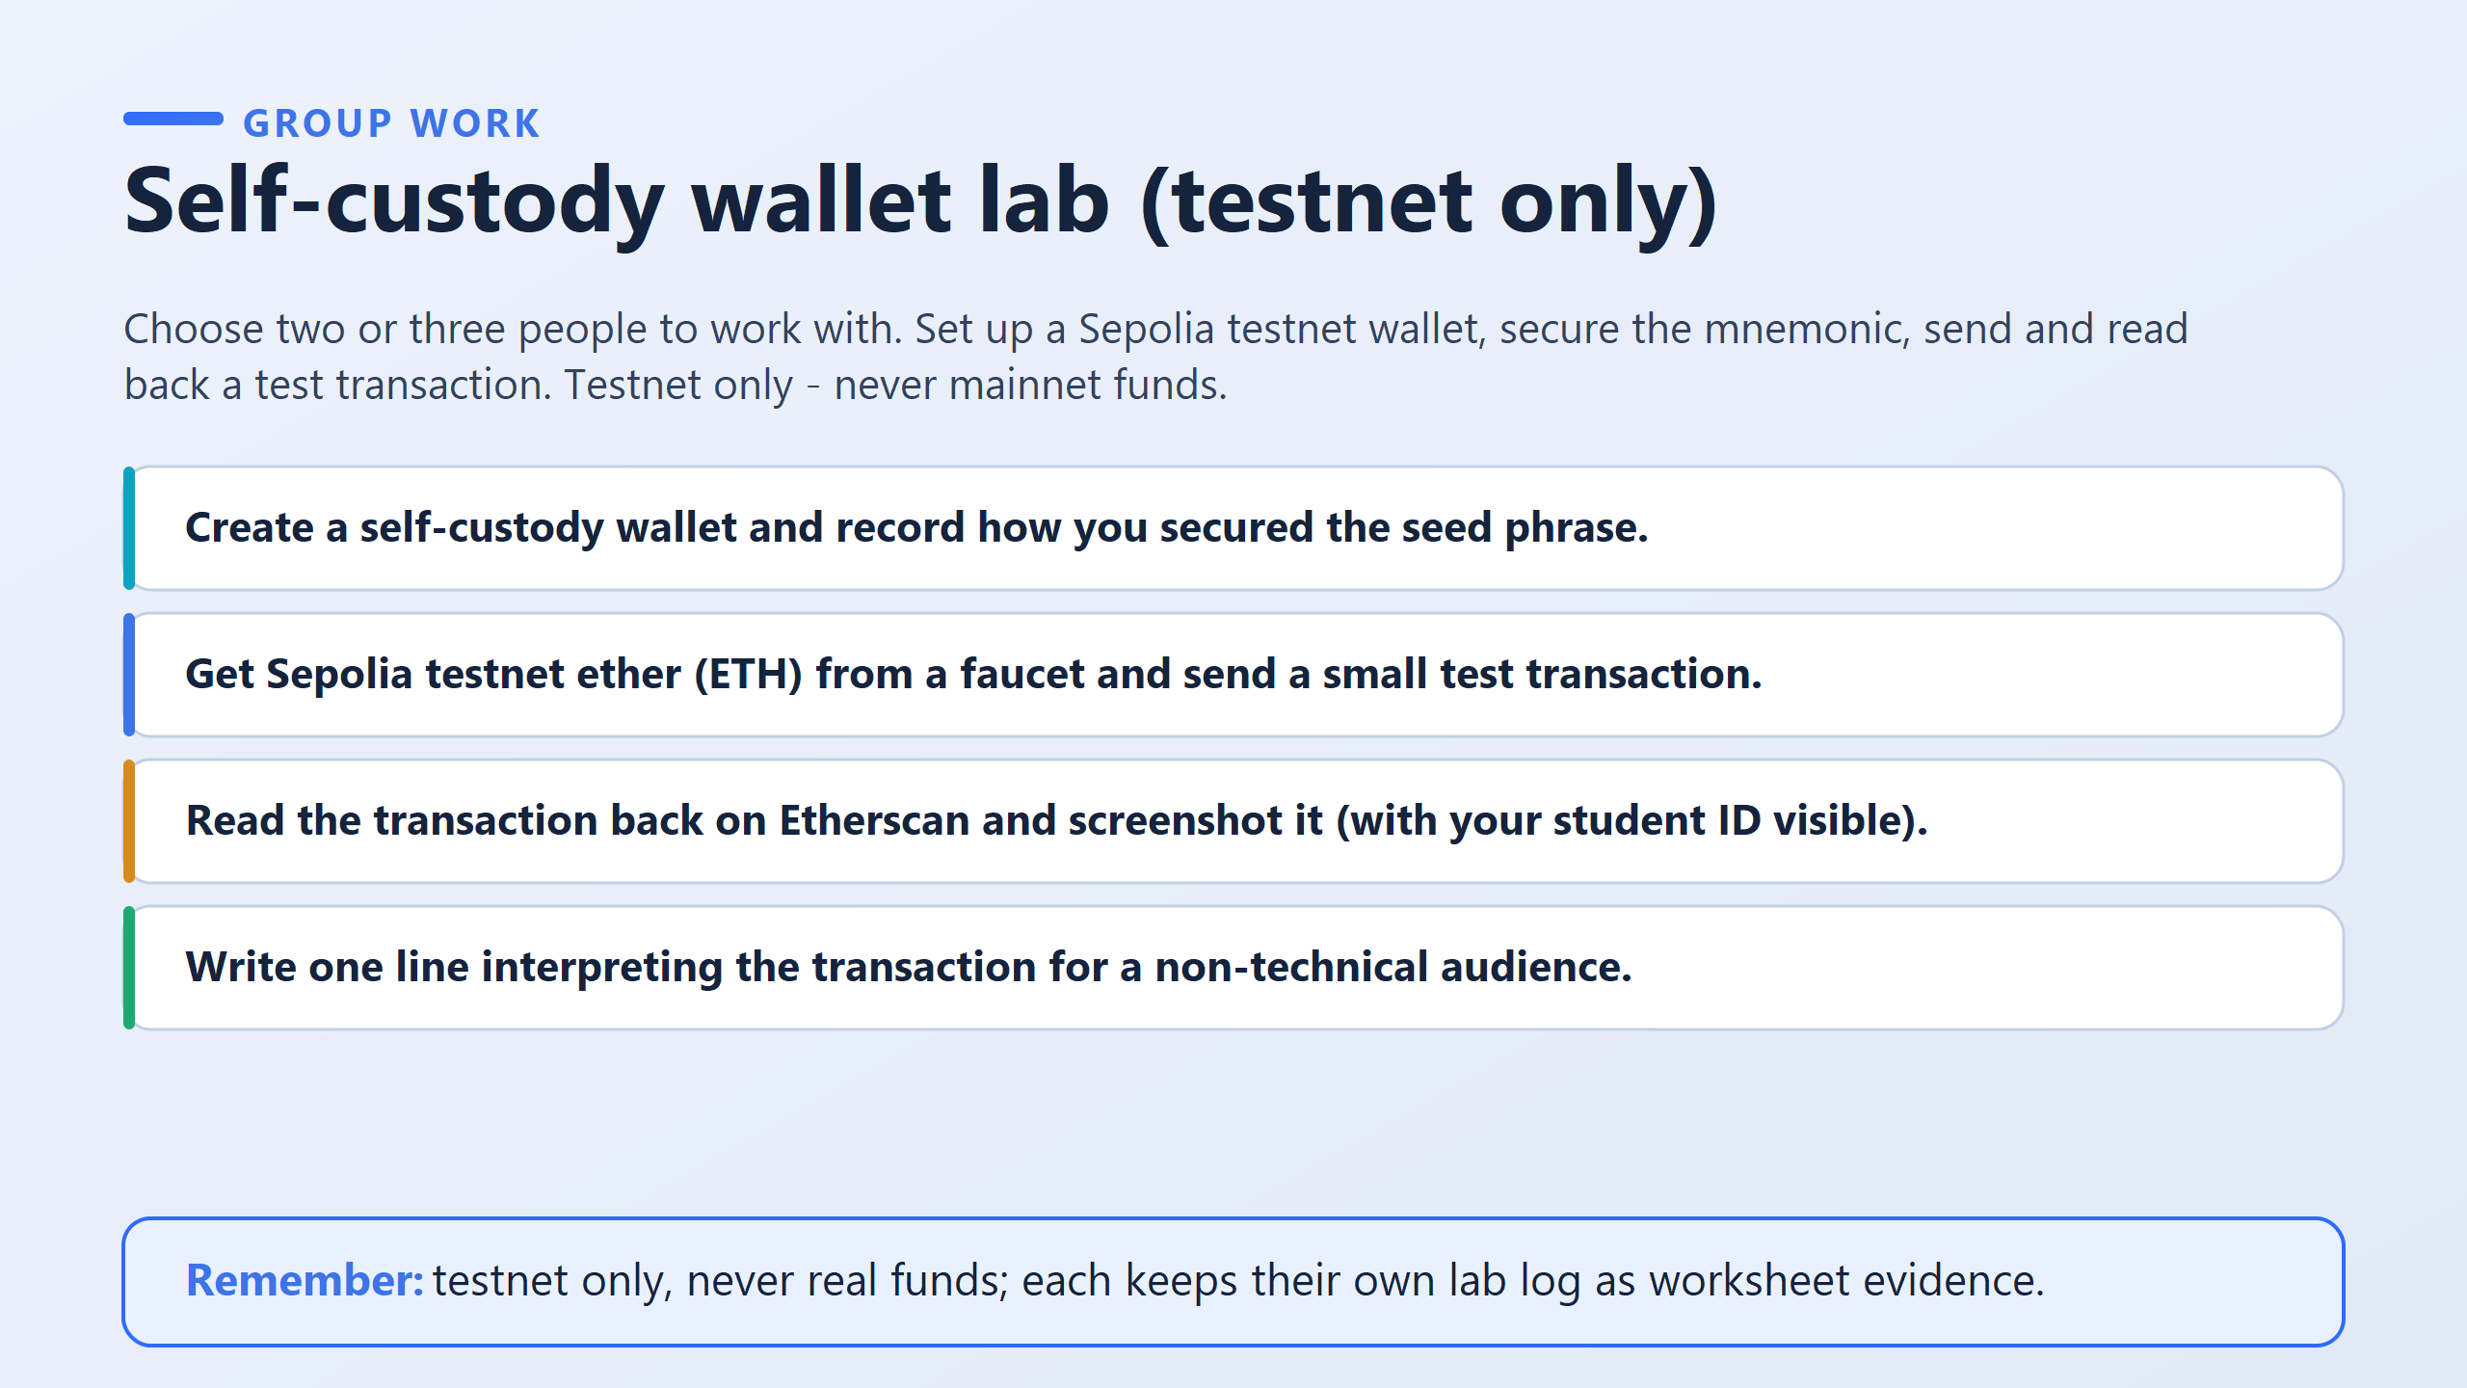

Slide 13
How to run this activity
Work individually — everyone creates their own wallet and keeps their own lab log.
The log is your personal evidence for your own worksheet, not something a group hands in once.
Practice network only. Never real funds.
Never use a seed phrase anywhere else, ever.
Every wallet made today is disposable.
What "finished" actually looks like (this is where marks are lost)
Seed phrase step: you are not marked for having a phrase. You’re marked for explaining how you secured it — could anyone else reach it, and what happens if the paper is lost? That’s the real answer.
Transaction step: your screenshot must show your student ID number in the photo.
No visible ID, no proof it's yours.
Good: names who sent, who received, how much moved, and confirms the network accepted it — in words a family member could follow.
Weak: just copies a long string of characters off the screen and stops there.

Slide 14
Step 1: Create a Self-Custody Wallet & Secure Seed Phrase
Download a Wallet Extension: Install a browser extension wallet like MetaMask or Rabby Wallet.
Resource Link: MetaMask Official Website
Create New Wallet:
Click "Create a new wallet" and set a strong, secure password for local application access.
Secure the Seed Phrase (Mnemonic):
Reveal your 12-word or 24-word Secret Recovery Phrase.
Write down the words on physical paper in the exact order shown.
Store the paper in a safe location away from digital devices. Avoid taking screenshots, saving it to cloud storage, or sending it in digital messages.
Lab Log Evidence (Task 1):
Write down your explanation of how you secured it (e.g., "Recorded the 12-word seed phrase on paper and stored it in a physical binder; avoided digital copies to prevent online exposure.").
Step 2: Switch to Sepolia Testnet & Get Sepolia ETH
Show Testnet Networks in MetaMask:
Open MetaMask settings →Advanced →Toggle "Show test networks" to ON.
Select "Sepolia" from the network selector dropdown at the top left.
Copy Public Address:
Copy your public wallet address (starts with 0x...).
Obtain Testnet ETH from a Faucet:

Slide 15
Visit an active Sepolia faucet to request free test tokens.
Resource Link 1: Google Cloud Sepolia Faucet
Resource Link 2: Alchemy Sepolia Faucet
Paste your address into the faucet bar, complete the captcha/login requirements, and request test ETH.
Step 3: Send Test Transaction to a Group Member
Obtain Peer's Address: Ask one of your group members for their Sepolia wallet address.
Execute the Send:
Click "Send" in your wallet.
Paste your partner's wallet address into the destination bar.
Enter a small amount (e.g., 0.001 Sepolia ETH).
Confirm the transaction fee (Gas) and click "Confirm".
Copy Transaction Hash:
Once the transaction completes, click on it in your activity tab to copy the Transaction Hash (TxHash).
Step 4: Read Transaction on Etherscan & Capture Screenshot
Open Sepolia Etherscan:
Resource Link: Sepolia Etherscan Block Explorer
Search for Transaction:
Paste your Transaction Hash (or your wallet address) into the search bar.

Slide 16
Take Screenshot (Task 3):
Locate key transaction details on the page:
Transaction Hash
Status (Success)
From (Your address)
To (Partner's address)
Value (e.g., 0.001 Sepolia ETH)
Required Action: Take a full-screen or browser window screenshot showing this Etherscan page with your Student ID card physically placed next to the screen or digitally visible alongside your lab log window as requested by your instructor.
Step 5: Write Non-Technical Interpretation (Task 4)
Write a clear, non-technical sentence explaining the process:
Non-Technical Explanation:
"I digitally signed and transferred 0.001 test currency tokens directly to my group partner's wallet address without using a bank, and the Ethereum test network verified and permanently recorded the transfer on a public digital ledger.

Slide 17
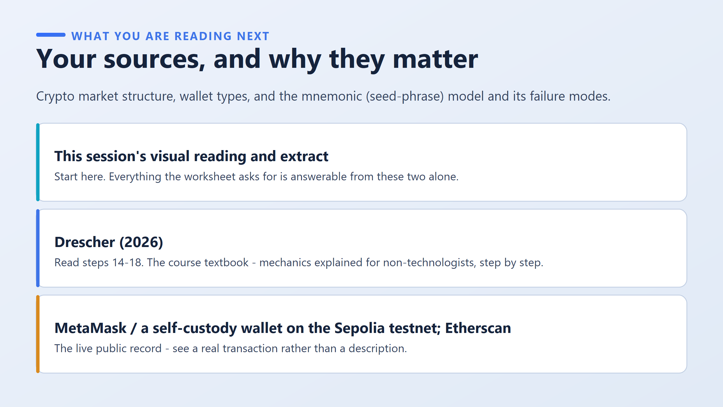

Slide 18
